Slide 1
Complexity Analysis (Part II)
Asymptotic Complexity
Big-O (asymptotic) Notation
Proving Big-O Complexity
Some Big-O Complexity Classes
Big-O Growth Rate Comparisons
Some algorithms and their Big-O Complexities
Limitations of Big-O
Big-O Computation Rules
Determining complexity of code structures
Other Asymptotic Notations
Notes:
1

Slide 2
Motivation for Asymptotic Analysis
An exact computation of worst-case running time can be difficult
  Function may have many terms:
    4n² - 3n log n + 17.5 n - 43 n^{⅔} + 75
An exact computation of worst-case running time is unnecessary
  Remember that we are already approximating running time by using RAM model

Slide 3
Simplifications
Ignore constants
  4n² - 3n log n + 17.5 n - 43 n^{⅔} + 75 becomes
  n² – n log n + n - n^{⅔} + 1
Asymptotic Efficiency
  n² – n log n + n - n^{⅔} + 1 becomes n²
End Result: Θ(n²)

Slide 4
Why ignore constants?
RAM model introduces errors in constants
  Do all instructions take equal time?
  Specific implementation (hardware, code optimizations) can speed up an algorithm by constant factors
  We want to understand how effective an algorithm is independent of these factors
Simplification of analysis
  Much easier to analyze if we focus only on n² rather than worrying about 3.7 n² or 3.9 n²

Slide 5
Asymptotic Analysis
We focus on the infinite set of large n ignoring small values of n
Usually, an algorithm that is asymptotically more efficient will be the best choice for all but very small inputs.
0
infinity

Slide 6

Θ-notation
For function g(n), we define Θ(g(n)), big-Theta of n, as the set:
Θ(g(n)) = {f(n) :
∃ positive constants c₁, c₂, and n_{0,} such that ∀n ≥ n₀,
we have 0 ≤ c₁g(n) ≤ f(n) ≤ c₂g(n)}
Intuitively: Set of all functions that
have the same rate of growth as g(n).
g(n) is an asymptotically tight bound for f(n).
Comp 122

Slide 7
Θ-notation
For function g(n), we define Θ(g(n)), big-Theta of n, as the set:
Θ(g(n)) = {f(n) :
∃ positive constants c₁, c₂, and n_{0,} such that ∀n ≥ n₀,
we have 0 ≤ c₁g(n) ≤ f(n) ≤ c₂g(n)}
Technically, f(n) ∈ Θ(g(n)).
Older usage, f(n) = Θ(g(n)).
I’ll accept either…
f(n) and g(n) are nonnegative, for large n.
Comp 122

Slide 8

O-notation
For function g(n), we define O(g(n)), big-O of n, as the set:
O(g(n)) = {f(n) :
∃ positive constants c and n_{0,} such that ∀n ≥ n₀,
we have 0 ≤ f(n) ≤ cg(n) }
Intuitively: Set of all functions whose rate of growth is the same as or lower than that of g(n).
g(n) is an asymptotic upper bound for f(n).
f(n) = Θ(g(n)) ⇒ f(n) = O(g(n)).
Θ(g(n)) ⊂ O(g(n)).
Comp 122

Slide 9

Ω -notation
For function g(n), we define Ω(g(n)), big-Omega of n, as the set:
Ω(g(n)) = {f(n) :
∃ positive constants c and n_{0,} such that ∀n ≥ n₀,
we have 0 ≤ cg(n) ≤ f(n)}
Intuitively: Set of all functions whose rate of growth is the same as or higher than that of g(n).
g(n) is an asymptotic lower bound for f(n).
f(n) = Θ(g(n)) ⇒ f(n) = Ω(g(n)).
Θ(g(n)) ⊂ Ω(g(n)).
Comp 122

Slide 10
Relations Between Θ, O, Ω
Comp 122

Slide 11
Relations Between Θ, Ω, O
Theorem : For any two functions g(n) and f(n),
f(n) = Θ(g(n)) iff
f(n) = O(g(n)) and f(n) = Ω(g(n)).
i.e., Θ(g(n)) = O(g(n)) ∩ Ω(g(n))
In practice, asymptotically tight bounds are obtained from asymptotic upper and lower bounds.
Comp 122

Slide 12
Two Other Sets
f(n) = o(g(n)) means c × g(n) is a strict upper bound on f(n)
f(n) = ω(g(n)) means c × g(n) is a strict lower bound on f(n)
These bounds hold for all inputs beyond some threshold n₀ where n₀ is now dependent on c.
Notes:
Asymptotic or Big-O notation.
O Omega Sigma

Slide 13
Common Complexity Functions
Complexity 10 20 30 40 50 60
n 1×10⁻⁵ sec 2×10⁻⁵ sec 3×10⁻⁵ sec 4×10⁻⁵ sec 5×10⁻⁵ sec 6×10⁻⁵ sec
n² 0.0001 sec 0.0004 sec 0.0009 sec 0.016 sec 0.025 sec 0.036 sec
n³ 0.001 sec 0.008 sec 0.027 sec 0.064 sec 0.125 sec 0.216 sec
n⁵ 0.1 sec 3.2 sec 24.3 sec 1.7 min 5.2 min 13.0 min
2^{n} 0.001sec 1.0 sec 17.9 min 12.7 days 35.7 years 366 cent
3^{n} 0.59sec 58 min 6.5 years 3855 cent 2×10⁸cent 1.3×10¹³cent
log₂ n 3×10⁻⁶ sec 4×10⁻⁶ sec 5×10⁻⁶ sec 5×10⁻⁶ sec 6×10⁻⁶ sec 6×10⁻⁶ sec
n log₂ n 3×10⁻⁵ sec 9×10⁻⁵ sec 0.0001 sec 0.0002 sec 0.0003 sec 0.0004 sec

Slide 14
Asymptotic Complexity: Example
Consider f(n) = 2n² + 4n + 4
Let us approximate f(n) by g(n) = n² , because n² is the dominant term in f(n) (the highest-order term)
Then we need to find a function c *g(n) that is an upper bound of f(n) for sufficiently large values of n:
    i.e., f(n) ≤ c*g(n)
    → 2n² + 4n + 4 ≤ cn² (1)
    → 2 + 4/n + 4/n² ≤ c (2)
By substituting different problem sizes in (2) we get different values of c. Hence there is an infinite number of pairs (n₀, c) that satisfy (2)
An such pair can be used in the definition:
f(n) ≤ c*g(n) ∀ n ≥ n₀
Three such pairs are (n₀ = 1, c = 10), (n₀ = 2, c = 5),
(n₀ = 4, c = 3.25)
Notes:
1

Slide 15
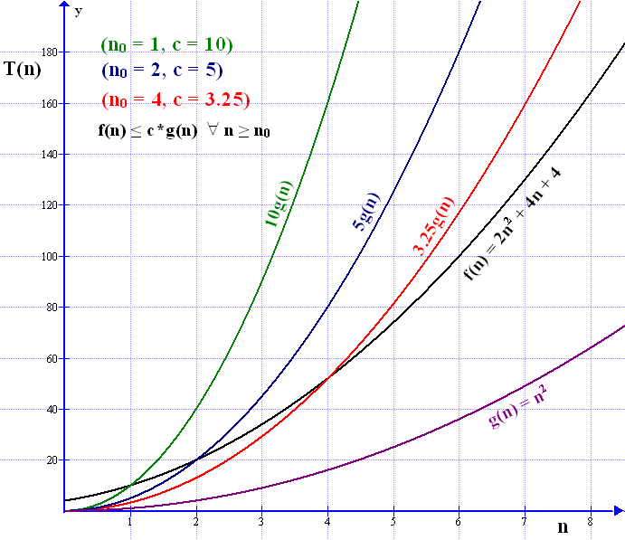
Asymptotic Complexity: Example (cont’d)
Notes:
1

Slide 16
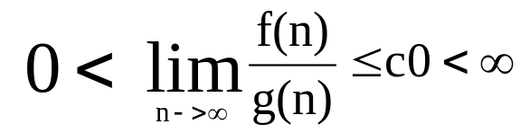
Big-O Notation (cont’d)
Implication of the definition:
For all sufficiently large n, c *g(n) is an upper bound of f(n)
f(n) ∈ O(g(n)) if
Note: By the definition of Big-O:
f(n) = 3n + 4 is O(n)
i.e., 3n + 4 ≤ cn
→ 3n + 4 ≤ cn² →f(n) is also O(n²),
→ 3n + 4 ≤ cn³ →f(n) is also O(n³),
. . .
→ 3n + 4 ≤ cn^{n} →f(n) is also O(n^{n})
However when Big-O notation is used, the function g in the relationship f(n) is O(g(n)) is CHOOSEN TO BE AS SMALL AS POSSIBLE.
  We call such a function g(n) a tight asymptotic bound of f(n)
  Thus we say 3n + 4 is O(n) rather than 3n + 4 is O(n²)
Notes:
1

Slide 17
Proving Big-O Complexity
To prove that f(n) is O(g(n)) we find any pair of values n₀ and c that satisfy:
f(n) ≤ c * g(n) for ∀ n ≥ n₀
Note: The pair (n₀, c) is not unique. If such a pair exists then there is an infinite number of such pairs.
Example: Prove that f(n) = 3n² + 5 is O(n²)
By the definition of Big-O: If 3n² + 5 is O(n²), then:
3n² + 5 ≤ cn²
→ 3 + 5/n² ≤ c
By putting different values for n, we get corresponding values for c:
Hence f(n) is O(n²) because f(n) ≤ 4.25 n² ∀ n ≥ 2
or f(n) is O(n²) because f(n ) ≤ 3.3125 n² ∀ n ≥ 4
n₀ | 1 | 2 | 3 | 4 | . . .
c | 8 | 4.25 | 3.55 | 3.3125 | . . .
Notes:
1

Slide 18
Proving Big-O Complexity (cont’d)
Example:
Prove that f(n) = 3n + 4 log n + 10 is O(n) by finding appropriate values for c and n₀
By the definition of Big-O: If 3n + 4 log n + 10 is O(n), then:
3n + 4 log n + 10 ≤ cn
→ 3 + 4 log n / n + 10/n ≤ c
By putting different values for n and using log₂n, we get corresponding values
for c:
Hence f(n) is O(n) because f(n) ≤ 13n ∀ n ≥ 1
or f(n) is O(n) because f(n) ≤ 5.75n ∀ n ≥ 8
n₀ | 1 | 2 | 4 | 8 | . . .
c | 13 | 10 | 7.5 | 5.75 | . . .
Notes:
1

Slide 19
Proving Big-O Complexity (cont’d)
Example:
Prove that f(n) = 4n⁴ + 2n³ + 3n is not O(n³)
Assume f(n) is O(n³), then by the definition of Big-O:
4n⁴ + 2n³ + 3n ≤ cn³ (1)
→ 4n + 2 + 3/n² ≤ c (2)
But the above is a contradiction, because c is a fixed constant it cannot be
bounded by function that approaches ∞ as n approaches ∞.
→ For any c, we can find a value of n such that (2) is not valid
Hence f(n) = 4n³ + 2n² + 3 is not O(n²)
Notes:
1

Slide 20
Some Big-O Complexity Classes
Some Big-O complexity classes in order of magnitude from smallest to highest:
Class | name
O(1) | constant
O(log log n) | bi-logarithmic or log log n
O(log n) | logarithmic or log n
O((log n)^{k}) or O(log^{k}n( | poly-logarithmic
O(n^{0.5})
O(n) | linear
O(n log n) | linear logarithmic or n log n
O(n²) | quadratic
O(n² log n) | quadratic logarithmic
O(n³) | cubic
O(2^{n}) | base-2 exponential
O(e^{n}) | natural exponential
O(3^{n}) | base-3 exponential
O(n!) | factorial
O(n^{n}) | hyper-exponential
Note: For any k > 0
log ^{k} n ∈ O(n^{0.5})
Example: log⁷⁰⁰n ∈ O(n^{0.5})
Note: For any constants k ≥ 2 , c > 1
and for sufficiently large n, an algorithm that is O(n^{k}) is more efficient than one that is O(c^{n})
An algorithm that is O(n^{k}) is called a polynomial algorithm. An algorithm that is O(c^{n}) is called an exponential algorithm.
Algorithms whose run-time are independent of the size of the problem’s inputs are
said to have constant time complexity: O(1)
Notes:
1

Slide 21
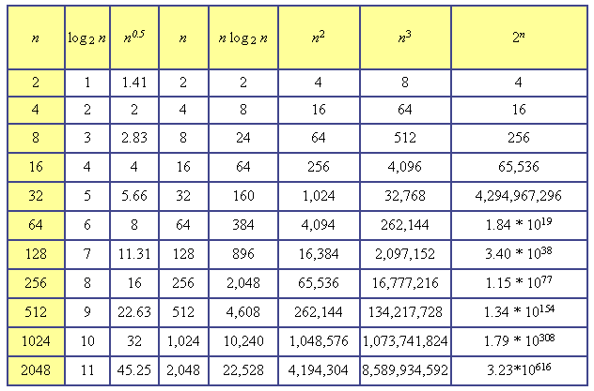
Big-O: Comparison of Growth Rates
Increasing complexity
Increasing problem size
Notes:
1

Slide 22
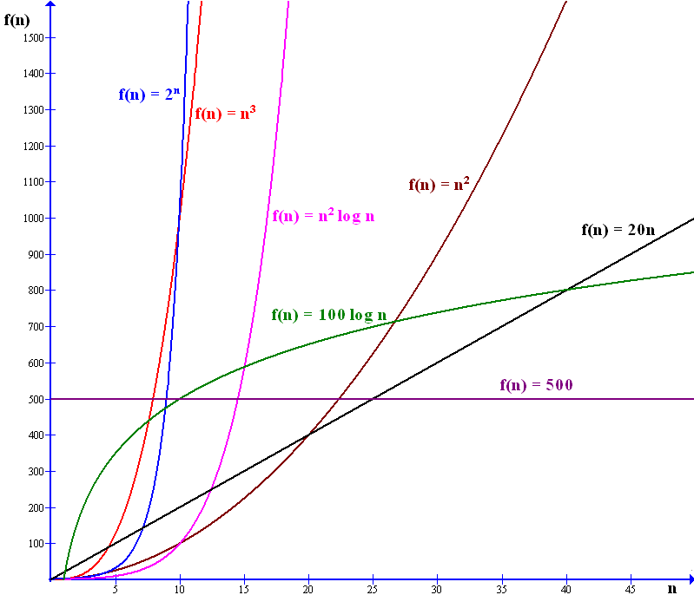
Big-O: Comparison of Growth Rates (cont’d)
Notes:
1

Slide 23
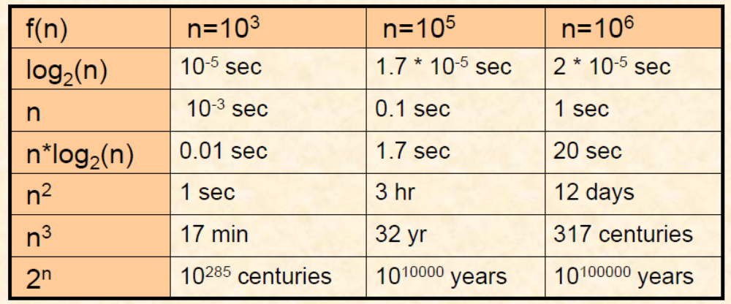
Big-O: Comparison of Growth Rates (cont’d)
Assume that a computer executes one million instructions per second
The chart below summarizes the amount of time required to execute f(n)
instructions on this machine for various values of n:
A problem is said to be intractable if solving it by computer is impractical
Algorithms with time complexity of O(2^{n}) are intractable, they take too long to
solve even for moderate values of n
Notes:
1

Slide 24
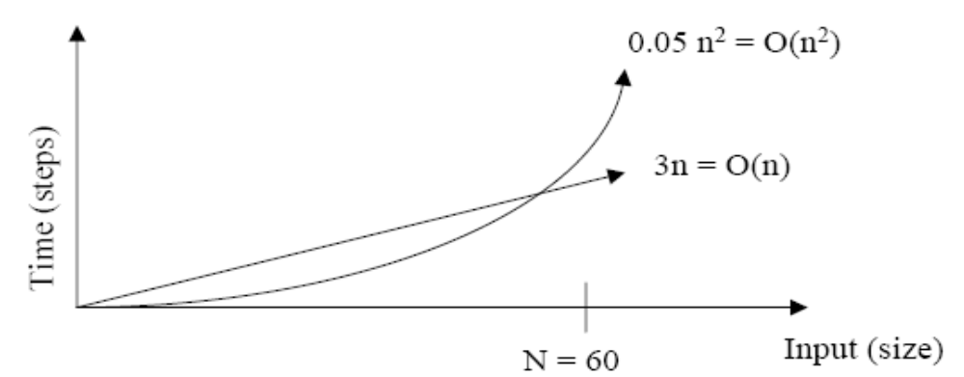
Big-O: Comparison of Growth Rates (cont’d)
As inputs get larger, any algorithm of a smaller order will be more efficient than an algorithm of a larger order.
Example1: Consider f(n) = 3n, and f(n) = 0.05n²
For ∀ n ≥ 60, the algorithm with f(n) = 3n is more efficient.
Example2: Consider f(n) = 1000 n, and f(n) = n²/1000
For ∀ n ≥ 1000000, the algorithm with f(n) = 1000 n is more efficient.
Notes:
1

Slide 25
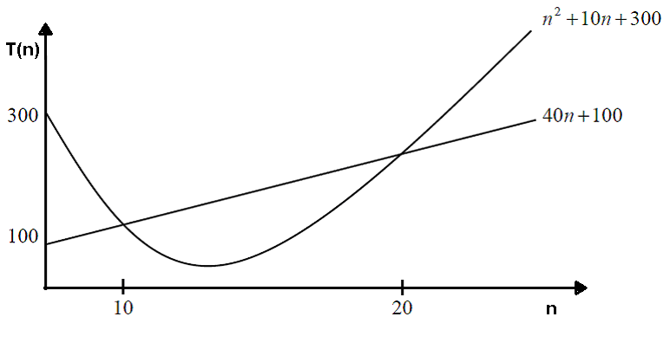
Big-O: Comparison of Growth Rates (cont’d)
Example 3: Consider f(n) = 40n + 100, and f(n) = n² + 10n + 300
For ∀ n ≥ 20, the algorithm with f(n) = 40n + 100 is more efficient.
Note: As stated in the previous lecture the behaviour of T(n) for small
n is ignored, as it may be meaningless as in the above example
Notes:
1

Slide 26
Big-O: Comparison of Growth Rates (cont’d)
Example 4:
We have two algorithms that solve a certain problem:
Algorithm A takes T_{A}(n) = n³ + 5n² + 100n
Algorithm B takes T_{B}(n) = 1000n² + 1000n
When is algorithm B more efficient than algorithm A?
Algorithm B is more efficient than algorithm A if T_{A}(n) > T_{B}(n) ∀ n ≥ n₀
→ n³ + 5n² + 100n > 1000n² + 1000n
n³ – 995n² – 900n > 0
n(n² – 995n – 900) > 0
n² – 995^{n} > 900
n(n – 995) > 900
n₀ ≥ 996
Notes:
1

Slide 27

Some Algorithms and their Big-O complexities
Big-O Notation | Examples of Algorithms
O(1) | Accessing an array element, Constant loops, Push, Pop, Enqueue (if there is a tail reference), Dequeue
O(log(n)) | Binary search
O(n) | Linear search, Summing a 1D-array
O(n log(n)) | Heap sort, Quick sort (average-case), Merge sort
O(n²) | Selection sort, Insertion sort, Bubble sort, Summing a 2D-array of size n*n
O(n³) | Matrix multiplication
O(2^{n}) | Towers of Hanoi, Recursive Fibonacci, Finding the (exact) solution to the traveling salesman problem (TSP) using dynamic programming
O(n!) | Solving the traveling salesman problem via brute-force search
O(n^{n}) | Ackermann function
TSP: Given a list of cities and their pair wise distances, the task is to find a shortest possible tour that visits each city exactly once
Notes:
1

Slide 28
Limitations of Big-O Notation
Big-O notation cannot compare algorithms in the same complexity class.
Big-O notation only gives sensible comparisons of algorithms in different complexity classes when n is large.
Notes:
1

Slide 29
Rules for using Big-O
For large values of input n , the constants and terms with lower degree of n are ignored.
Multiplicative Constants Rule: Ignoring constant factors
O(c f(n)) = O(f(n)), where c is a constant > 0
Example: O(20 n³) = O(n³)
An implication of this rule is that in Asymptotic Analysis logarithm bases are irrelevant since:
log _{a} x = log _{b} x / log _{b} a = constant * log _{b} x
Example: O(log _{b}(n^{k})) = O(k log _{b} n) = O(log n)
2. Addition Rule: Ignoring smaller terms
If O(f(n)) < O(h(n)) then O(f(n) + h(n)) = O(h(n))
Examples:
  O(n² log n + n³) = O(n³)
  O(2000 n³ + 2n ! + n⁸⁰⁰ + 10n + 27n log n + 5) = O(n !)
  log(n⁵⁰⁰ + 2n² + n + 40) ∈ O(log n⁵⁰⁰) = O(500 log n) = O(log n)
3. Multiplication Rule: O(f(n) * h(n)) = O(f(n)) * O(h(n))
Example:
O((n³ + 2n ² + 3n log n + 7)(8n ² + 5n + 2)) = O(n ⁵)
Notes:
1

Slide 30
Determining complexity of code structures
Loops:
Complexity is determined by the number of iterations in the loop times the complexity of the body of the loop.
Examples:
for (int i = 0; i < n; i++)
sum = sum - i;
O(n)
for (int i = 0; i < n * n; i++)
sum = sum + i;
O(n²)
int i=1;
while (i < n) {
sum = sum + i;
i = i*2
}
O(log n)
for(int i = 0; i < 100000; i++)
sum = sum + i;
O(1)
Notes:
1

Slide 31
Determining complexity of code structures
Nested independent loops:
Complexity of inner loop * complexity of outer loop.
Examples:
int sum = 0;
for(int i = 0; i < n; i++)
for(int j = 0; j < n; j++)
sum += i * j ;
O(n²)
int i = 1, j;
while(i <= n) {
j = 1;
while(j <= n){
statements of constant complexity
j = j*2;
}
i = i+1;
}
O(n log n)
Notes:
1

Slide 32
Determining complexity of code structures (cont’d)
Nested dependent loops: Examples:
int sum = 0;
for(int i = 1; i <= n; i++)
for(int j = 1; j <= i; j++)
sum += i * j ;
Number of repetitions of the inner loop is: 1 + 2 + 3 + . . . + n = n(n+2)/2
Hence the segment is O(n²)
int sum = 0;
for(int i = 1; i <= n; i++)
for(int j = i; j < 0; j++)
sum += i * j ;
Number of repetitions of the inner loop is: 0
The outer loop iterates n times.
Hence the segment is O(n)
Notes:
1

Slide 33
Determining complexity of code structures (cont’d)
Note: An important question to consider in complexity analysis is whether the problem size is a variable or a constant.
Examples:
int n = 100;
// . . .
for(int i = 1; i <= n; i++)
for(int j = 1; j <= n; j++)
sum += i * j ;
n is constant; the segment is O(1)
int n;
do{
n = scannerObj.nextInt();
}while(n <= 0);
int sum = 0;
for(int i = 1; i <= n; i++)
for(int j = i; j <= n; j++)
sum += i * j ;
}
n is variable; hence the segment is O(n²)
Notes:
1

Slide 34
Determining complexity of code structures (cont’d)
int[] x = new int[100];
// . . .
for(int i = 0; i < x.length; i++)
sum += x[i] ;
x.length is constant; the segment is O(1)
int n;
int[] x = new int[100];
do{ // loop1
System.out.println(“Enter number of elements <= 100”);
n = scannerObj.nextInt();
}while(n < 1 || n > 100);
int sum = 0;
for(int i = 0; i < n; i++) // loop2
sum += x[i];
loop1 is O(n) if the loop terminates; otherwise its complexity cannot be determined.
n is variable; hence loop2 is O(n) (if loop1 terminates)
Notes:
1

Slide 35
Determining complexity of code structures (cont’d)
Sequence of statements: Use Addition rule
O(s1; s2; s3; … sk) = O(s1) + O(s2) + O(s3) + … + O(sk)
= O(max(s1, s2, s3, . . . , sk))
Example:
Complexity is O(n²) + O(n) + O(1) = O(n²)
for (int j = 0; j < n * n; j++)
sum = sum + j;
for (int k = 0; k < n; k++)
sum = sum - l;
System.out.print("sum is now ” + sum);
O(n²)
O(n)
O(1)
Notes:
1

Slide 36
Determining complexity of code structures (cont’d)
If Statement:
O(max(O(condition1), O(condition2), . . ,
O(branch1), O(branch2), . . ., O(branchN))
Example1:
char key;
  ........
  if(key == '+') {
  for(int i = 0; i < n; i++)
  for(int j = 0; j < n; j++)
  C[i][j] = A[i][j] + B[i][j];
  }
  else if(key == 'x')
  C = matrixMult(A, B, n);
  else
  System.out.println("Error! Enter '+' or 'x'!");
O(1)
O(n²)
Overall complexity
O(n³)
O(1)
O(n³)
O(1)
Notes:
1

Slide 37
Determining complexity of code structures (cont’d)
Example2:
O(if-else) = Max[O(Condition), O(if), O(else)]
int[] integers = new int[100];
// n is the problem size, n <= 100
........
if(hasPrimes(integers, n) == true)
integers[0] = 20;
else
integers[0] = -20;
public boolean hasPrimes(int[] x, int n) {
for(int i = 0; i < n; i++)
..........
..........
}
O(1)
O(1)
O(n)
O(if-else) = O(Condition) = O(n)
Notes:
1

Slide 38
Determining complexity of code structures (cont’d) Dominant if- statement branches
Note: Sometimes a loop may cause the if-else rule not to be applicable. Consider the following loop:
block1 is executed only once, block2 is executed n - 1 times
  Complexity is O(T(block1)) if T(block1) > (n – 1)*T(block2)
  Otherwise block2 is dominant:
Complexity is O(n*T(block2))
for(int i = 1; i <= n; i++) {
if(i == 1)
block1;
else
block2;
}
Notes:
1

Slide 39
Determining complexity of code structures (cont’d) Dominant if- statement branches
Consider the following loop:
The else-branch has more basic operations; therefore one may conclude that the loop is O(n). However the if-branch dominates:
For any integer n > 0, if n is odd, the else-branch is executed one time.
If n is even, the else-branch is not executed.
Hence the program fragment is O(log n)
while (n > 0) {
if (n % 2 == 0) {
System.out.println(n);
n = n / 2;
} else{
System.out.println(n);
System.out.println(n);
n = n – 1;
}
}
Notes:
1

Slide 40
Determining complexity of code structures (cont’d)
Switch: Take the complexity of the most expensive case including the default case
char key;
int[] x = new int[100];
int[][] y = new int[100][100];
........
// n is the problem size ( n <= 100)
switch(key) {
case 'a':
for(int i = 0; i < n; i++)
sum += x[i];
break;
case 'b':
for(int i = 0; i < n; j++)
for(int j = 0; j < n; j++)
sum += y[i][j];
break;
}
o(n)
o(n²)
Overall Complexity: o(n²)
Notes:
1

Slide 41
Other Asymptotic Notations
 | notation | definition | Mathematical definition ∃ c,c₁,c₂ > 0 and ∀n ≥ n₀
Big-O | f(n) ∈ O(g(n)) | asymptotic upper bound | f(n) ≤ cg(n)
little-o | f(n) ∈ o(g(n)) | upper bound that is not asymptotically tight | f(n) < cg(n)
little- ω | f(n) ∈ ω (g(n)) | lower bound that is not asymptotically tight | f(n) > cg(n)
Big- Ω | f(n) ∈ Ω (g(n)) | asymptotic lower bound | f(n) ≥ cg(n)
Theta | f(n) ∈ Θ(g(n)) | asymptotically tight bound | c₁g(n) ≤ f(n) ≤ c₂g(n) Note: f(n) is Θ (n) if it is both O(n) and Ω (n)
Note: Big-O is commonly used where Θ is meant, i.e., when a tight estimate is implied
Notes:
1

Slide 42
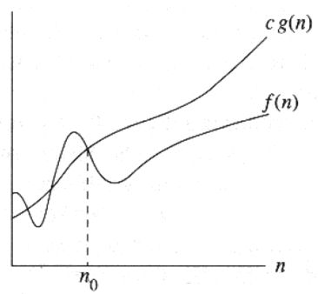
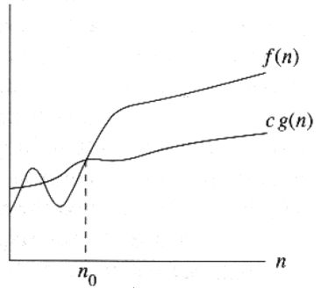
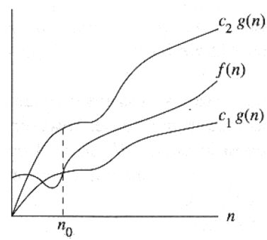
Other Asymptotic Notations (cont’d)
f(n) ∈ O(g(n))
f(n) ∈ Ω(g(n))
f(n) ∈ Θ(g(n))
Notes:
1

Slide 43
Asymptotic Complexity
Let f(n) be the worst-case time complexity for an algorithm.
We approximate f(n) by a function c *g(n), where:
  g(n) is a simpler function than f(n)
  c is a positive constant i.e., c > 0
  For sufficiently large values of the input size n, c*g(n) is an upper bound of f(n):
    → ∃ an input size n₀ such that ∀ n ≥ n₀, f(n) ≤ c*g(n)
O(g(n)) =
  {f(n) : there exists positive constants c and n₀ such that ∀ n≥n₀,
  0 ≤ f(n) ≤ c g(n) }
This "approximate" measure of efficiency is called asymptotic complexity.
Notes:
1

Slide 44
Three Common Sets
f(n) = O(g(n)) means c × g(n) is an Upper Bound on f(n)
f(n) = Ω(g(n)) means c × g(n) is a Lower Bound on f(n)
f(n) = Θ(g(n)) means c₁ × g(n) is an Upper Bound on f(n)
and c₂ × g(n) is a Lower Bound on f(n)
These bounds hold for all inputs beyond some threshold n₀.
Notes:
Asymptotic or Big-O notation.
O Omega Sigma

Slide 45
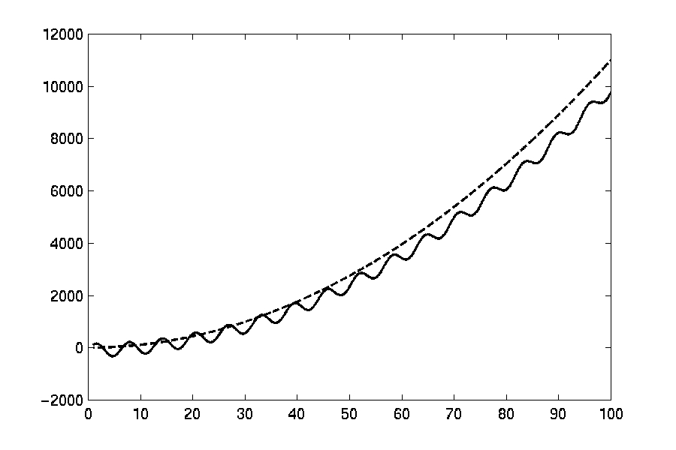
O(g(n))
c*g(n)
f(n)
n_{o}

Slide 46
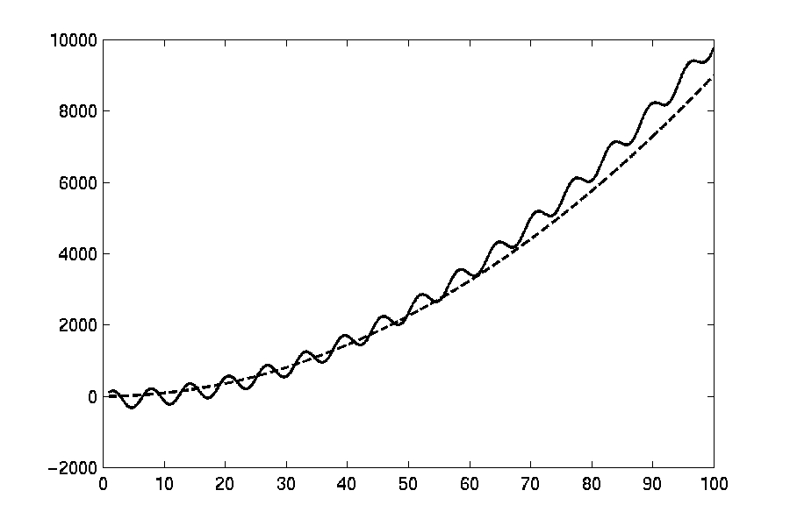
Ω(g(n))
f(n)
c*g(n)
n_{o}

Slide 47
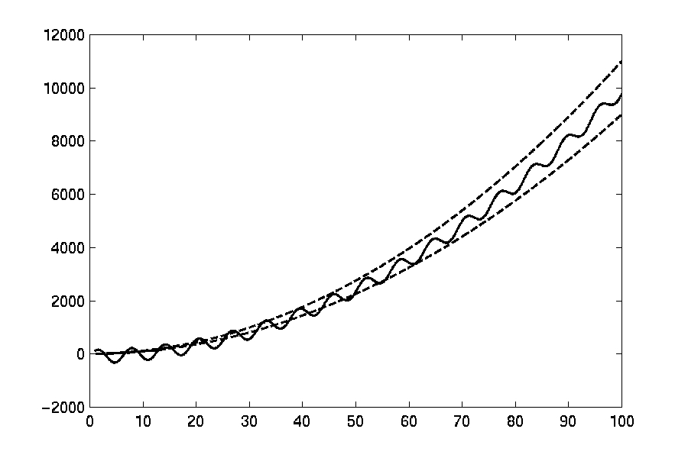
Θ(g(n))
c1*g(n)
f(n)
c2*g(n)
n_{o}

Slide 48
“Little Oh” Notation
o(g(n)) =
  {f(n) : ∀c >0 ∃n₀ > 0 such that ∀n ≥ n₀
  0 ≤ f(n) < cg(n)}
f(n) = o(g(n)) means c × g(n) is a strict upper bound on f(n)
f(n) = ω(g(n)) means c × g(n) is a strict lower bound on f(n)
These bounds hold for all inputs beyond some threshold n₀ where n₀ is now dependent on c.

